Slide 1
SHOPSMART
Your Digital Grocery Store Experience
Team ID : LTVIP2026TMIDS73436
Team Size : 5

Slide 2
Team Details
Team Leader: : N Devika
Team Member: A Jaya Sree
Team Member: G Jyothi
Team Member: M Reddy Sree
Team Member: M Aparna

Slide 3
Introduction
ShopSmart is a digital grocery shopping platform
Allows users to shop groceries online
Designed for convenience and efficiency

Slide 4
Problem Statement
Traditional grocery shopping is time-consuming
Long queues and limited store hours
Difficulty in comparing prices

Slide 5
Proposed Solution
Online grocery store system
Easy browsing and ordering
Secure payment and home delivery

Slide 6
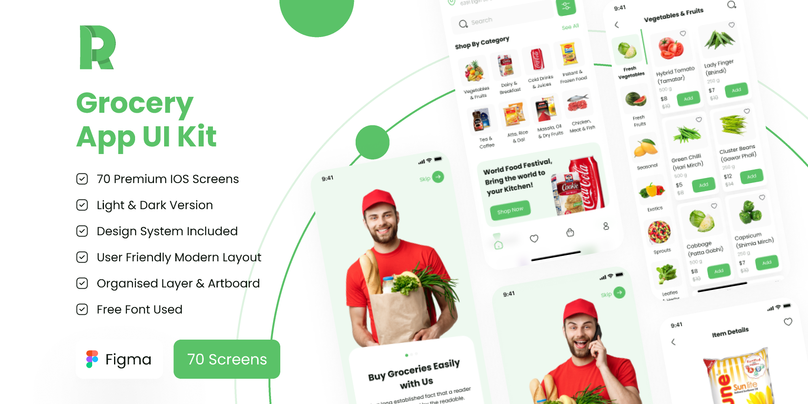
ShopSmart Application Interface

Slide 7
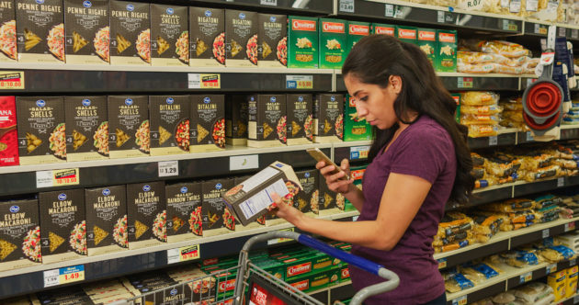
Online Grocery Shopping Concept

Slide 8
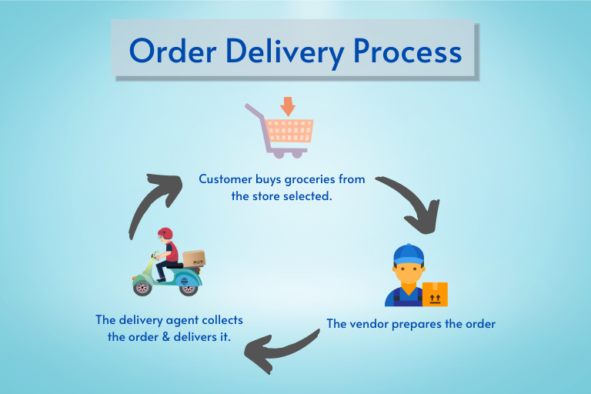
Order & Delivery System

Slide 9
Key Features
User registration and login
Search and add products to cart
Order tracking and payment options

Slide 10
Technology Used
Frontend: HTML, CSS, JavaScript
Backend: Python / Java / PHP
Database: MySQL / MongoDB

Slide 11
Conclusion
ShopSmart simplifies grocery shopping
Provides a modern digital solution
Enhances user convenience

